Slide 1

Ai planet

Slide 2
Introduction to AI Planet
AI Planet is committed to harnessing AI’s transformative power to solve real-world problems, addressing the challenge that over 85% of AI projects fail to drive meaningful impact.
With a thriving community of over 300,000 members, AI Planet empowers businesses and individuals through a unique ecosystem designed for AI education, development, and deployment.
Our GenAI Stack offers a secure developer platform for creating Generative AI and LLM applications, while our AI Marketplace enables enterprises to implement custom LLMs on private cloud.
Our Mission: To democratize AI by making it accessible and impactful across industries.

Slide 3
The Demand for AI in the Telecommunications Sector
The telecom industry is undergoing rapid digital transformation with AI
adoption in areas like network optimization, predictive maintenance, and customer service automation.
Market demand for AI-driven network management, customer personalization,
and service automation is surging, highlighting opportunities for AI-driven efficiency.
AI Planet’s solutions can address these needs, delivering advanced GenAI/ML
tools for predictive analytics, dynamic resource allocation, and enhanced customer engagement.

Slide 4
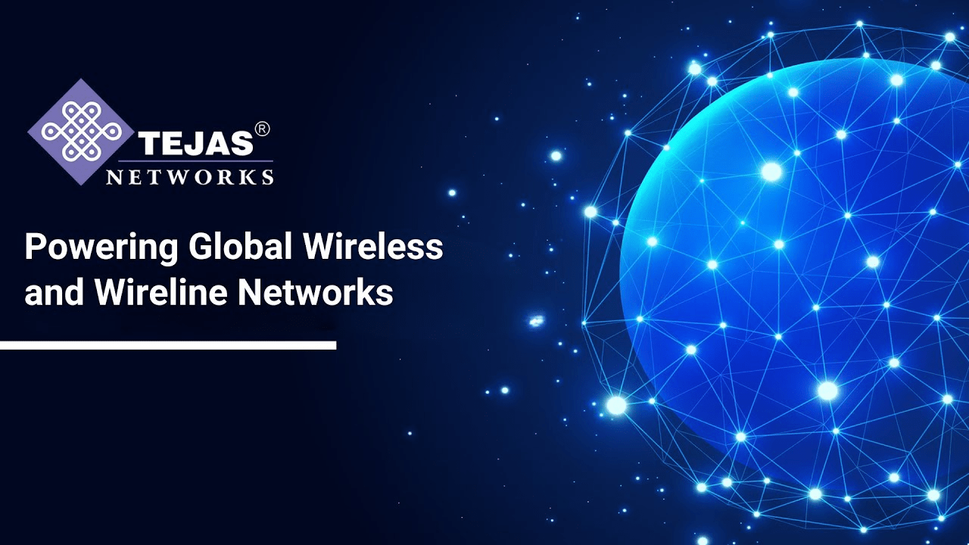
About Tejas Networks
Tejas Networks is an India-based telecom solutions provider offering
high-capacity data transport, broadband access, and wireless connectivity products.
Operating across 75+ countries, Tejas specializes in:
Optical Transmission: DWDM and OTN solutions.
Broadband Access: Carrier Ethernet and GPON for broadband expansion.
Wireless Access (4G/5G): LTE and emerging 5G solutions.
Network Management and Automation: Tools for streamlining operations.
AI Planet’s AI/ML solutions align with Tejas Networks’ focus on innovation,
supporting data-driven optimization and scalability.

Slide 5
Competitor List and AI/ML Insights
Cisco
Offerings: Routers, switches, SDN, cloud services, cybersecurity, collaboration tools like Webex, and 5G technologies.
AI/ML Strategy: Cisco integrates AI for network automation, predictive analytics, and threat detection. Cisco's Security Cloud and AI-driven Webex Contact Center utilize predictive AI to enhance network resilience and customer service.
Nokia
Offerings: Hardware and software for telecom, cloud-based cybersecurity solutions, and network automation.
AI/ML Strategy: Nokia employs AI for network optimization, predictive maintenance, and data analytics. Key uses include AI for 5G rollouts, reducing downtime and improving network efficiency with automated management.
Offerings: Networking, hybrid cloud, and 5G technology solutions.

Slide 6
Ericsson
Offerings: Telecom equipment, software, and mobile and fixed broadband solutions.
AI/ML Strategy: Ericsson uses AI to optimize 5G networks, automate network management, and manage data traffic. AI-driven solutions improve service reliability and reduce operational complexity for telecom operators.
Huawei
Offerings: Networking, hybrid cloud, and 5G technology solutions.
AI/ML Strategy: Huawei’s AI-enabled network tools facilitate predictive maintenance, network configuration, and real-time network traffic analysis. Huawei’s focus is on 5G optimization and intelligent network management.
Juniper Networks
Offerings: Networking, security, and cloud services for enterprise use.
AI/ML Strategy: AI tools from Juniper, like Junos Spotlight Secure, focus on real-time threat detection and network infrastructure security, enabling seamless and secure connectivity.

Slide 7
AI-Powered Network Optimization and Predictive Maintenance
Objective: Reduce network downtime and enhance operational efficiency.
AI Planet's GenAI and ML models simulate network conditions, predict equipment failures, and schedule proactive maintenance.
Impact: Enhances network resilience, reduces operational disruptions, and optimizes resource allocation.
Feasibility: Moderate – Requires historical network data; high-impact potential for operational stability.
https://teletimesinternational.com/2024/ai-transforming-predictive-maintenance-telecoms/

Slide 8
Customer Support Automation through Large Language Models (LLMs)
Objective: Improve customer service efficiency and reduce response times.
Content:
Leverage LLMs (like GPT) to automate inquiries, streamline ticket generation, and provide 24/7 support tailored for telecom services.
Impact: Enhances customer satisfaction and operational efficiency by automating common inquiries and improving response accuracy.
Feasibility: High – Customer support data is accessible, making LLM integration feasible with significant operational benefits.

Slide 9
Dynamic Traffic Management and Bandwidth Optimization
Objective: Maximize network resource utilization and enhance customer experience.
Content:
AI models analyze real-time traffic to allocate bandwidth dynamically, responding to peak demand and optimizing usage.
Impact: Improves network performance, reduces latency, and enhances the customer experience.
Feasibility: High – Traffic data can support ML models, allowing for responsive, real-time adjustments.

Slide 10
Strategic Benefits of AI Planet’s Solutions for Tejas Networks
Content:
AI Planet offers scalable, impactful AI/ML tools that align with Tejas Networks' mission of reliable, high-performance telecom solutions.
Key benefits for Tejas Networks:
Operational Efficiency: Predictive maintenance and network optimization minimize downtime.
Customer Engagement: LLM-driven automation enhances support and engagement.
Competitive Edge: Real-time analytics enable responsive service and resource optimization.
Closing Note: AI Planet’s ecosystem can empower Tejas Networks to lead in telecom innovation and customer satisfaction.

Slide 11
Conclusion
AI Planet empowers organizations with accessible AI tools, driving impactful solutions like network optimization, customer support automation, and dynamic pricing. Through our GenAI Stack and community-driven platform, we help Tejas Networks enhance operational efficiency and customer experience. Proposed AI/ML use cases include predictive maintenance, traffic management, and service personalization. Let's explore how AI Planet can help Tejas Networks innovate and stay ahead in the telecom industry.

Slide 12
Thank you

